Slide 1


SMART INDIA HACKATHON 2024
TITLE PAGE
Problem Statement ID – 1728
Problem Statement Title- Development of a Paperless Scholarship Disbursement System for PMSSS
Theme- Miscellaneous
PS Category- Software
Team ID-
Team Name (Registered on portal) - Devengers

Slide 2
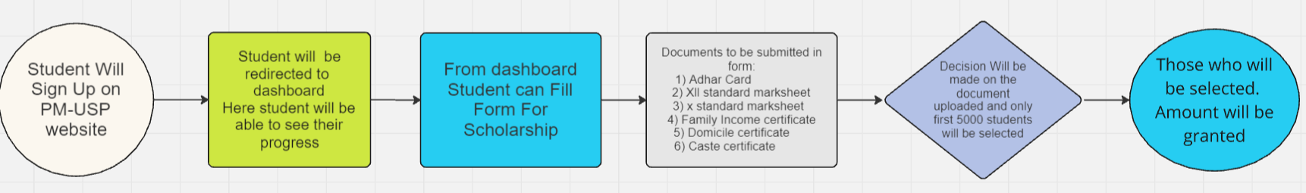
IDEA TITLE
DEVENGERS
Proposed Solution (Describe your Idea/Solution/Prototype)
Detailed explanation of the proposed solution
How it addresses the problem
1) No paper waste will be created 4) Student will get information about process on their phone
2) No requirement of Local office for doc verification 3) Process will become faster
Innovation and uniqueness of the solution
Decision of whether Student Application is accepted or rejected will be made in minutes.
We are using OCR (optical character recognition) model for fast process.
It can read thousands of different documents in multiple layouts and formats at high speed.
For data security and scalability we are using mongo DB

Slide 3
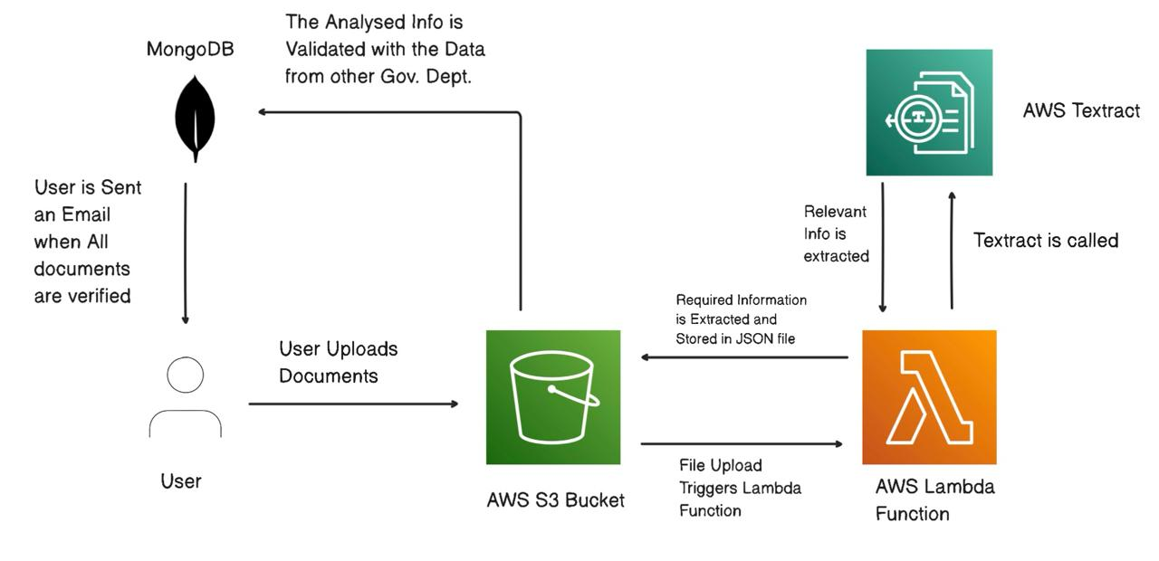
TECHNICAL APPROACH
DEVENGERS
Technologies to be used (e.g. programming languages, frameworks, hardware)
1) PHP/Laravel
2) Mongo DB
3) AWS
4) HTML/ Tailwind CSS /JavaScript
Methodology and process for implementation (Flow Charts/Images/ working prototype)

Slide 4
FEASIBILITY AND VIABILITY
DEVENGERS
Analysis of the feasibility of the idea
The digital scholarship management system is highly feasible due to its ability to automate processes, reduce manual effort, and enhance efficiency. Leveraging existing technologies like OCR and secure web platforms is technically achievable and aligns with modern trends in digital transformation, ensuring smooth implementation.
Potential challenges and risks
Challenges include ensuring data security, managing high traffic and server load, and achieving user adoption across diverse student demographics. Risks involve potential technical glitches, data breaches, and resistance from stakeholders accustomed to traditional processes.
Strategies for overcoming these challenges
To overcome these challenges, implement robust cybersecurity measures, use scalable cloud infrastructure, and provide comprehensive training and support for users. Engage stakeholders early through awareness campaigns and pilot testing to ensure smooth adoption and address potential concerns proactively.

Slide 5
IMPACT AND BENEFITS
DEVENGERS
Potential impact on the target audience
The digital scholarship management system will significantly benefit students by providing a faster, more efficient application process, reducing wait times, and improving accessibility. It will empower students from diverse backgrounds to apply easily, enhancing their opportunities for higher education without the burden of extensive paperwork
Benefits of the solution (social, economic, environmental, etc.)
The solution offers social benefits by increasing educational accessibility, economic benefits by reducing administrative costs and processing times, and environmental benefits by eliminating paper usage. It promotes transparency and efficiency in scholarship disbursement, ensuring fair and timely financial support for students.

Slide 6
RESEARCH AND REFERENCES
DEVENGERS
Details / Links of the reference and research work
https://docs.aws.amazon.com/textract/latest/dg/what-is.html
https://laravel.com/docs/11.x/readme
https://www.aicte-india.org/bureaus/jk

